Slide 1
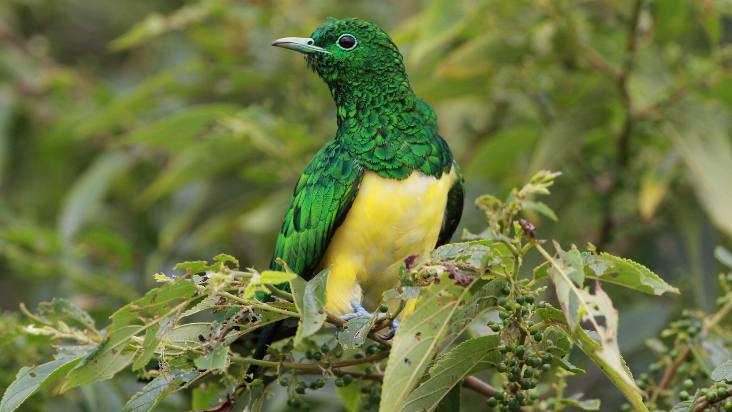

BeakPeek
Millennium
BIRDING MADE EASY AS FLY
Group 22

Slide 2
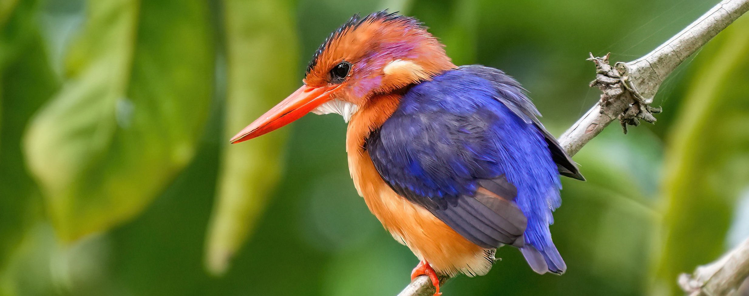

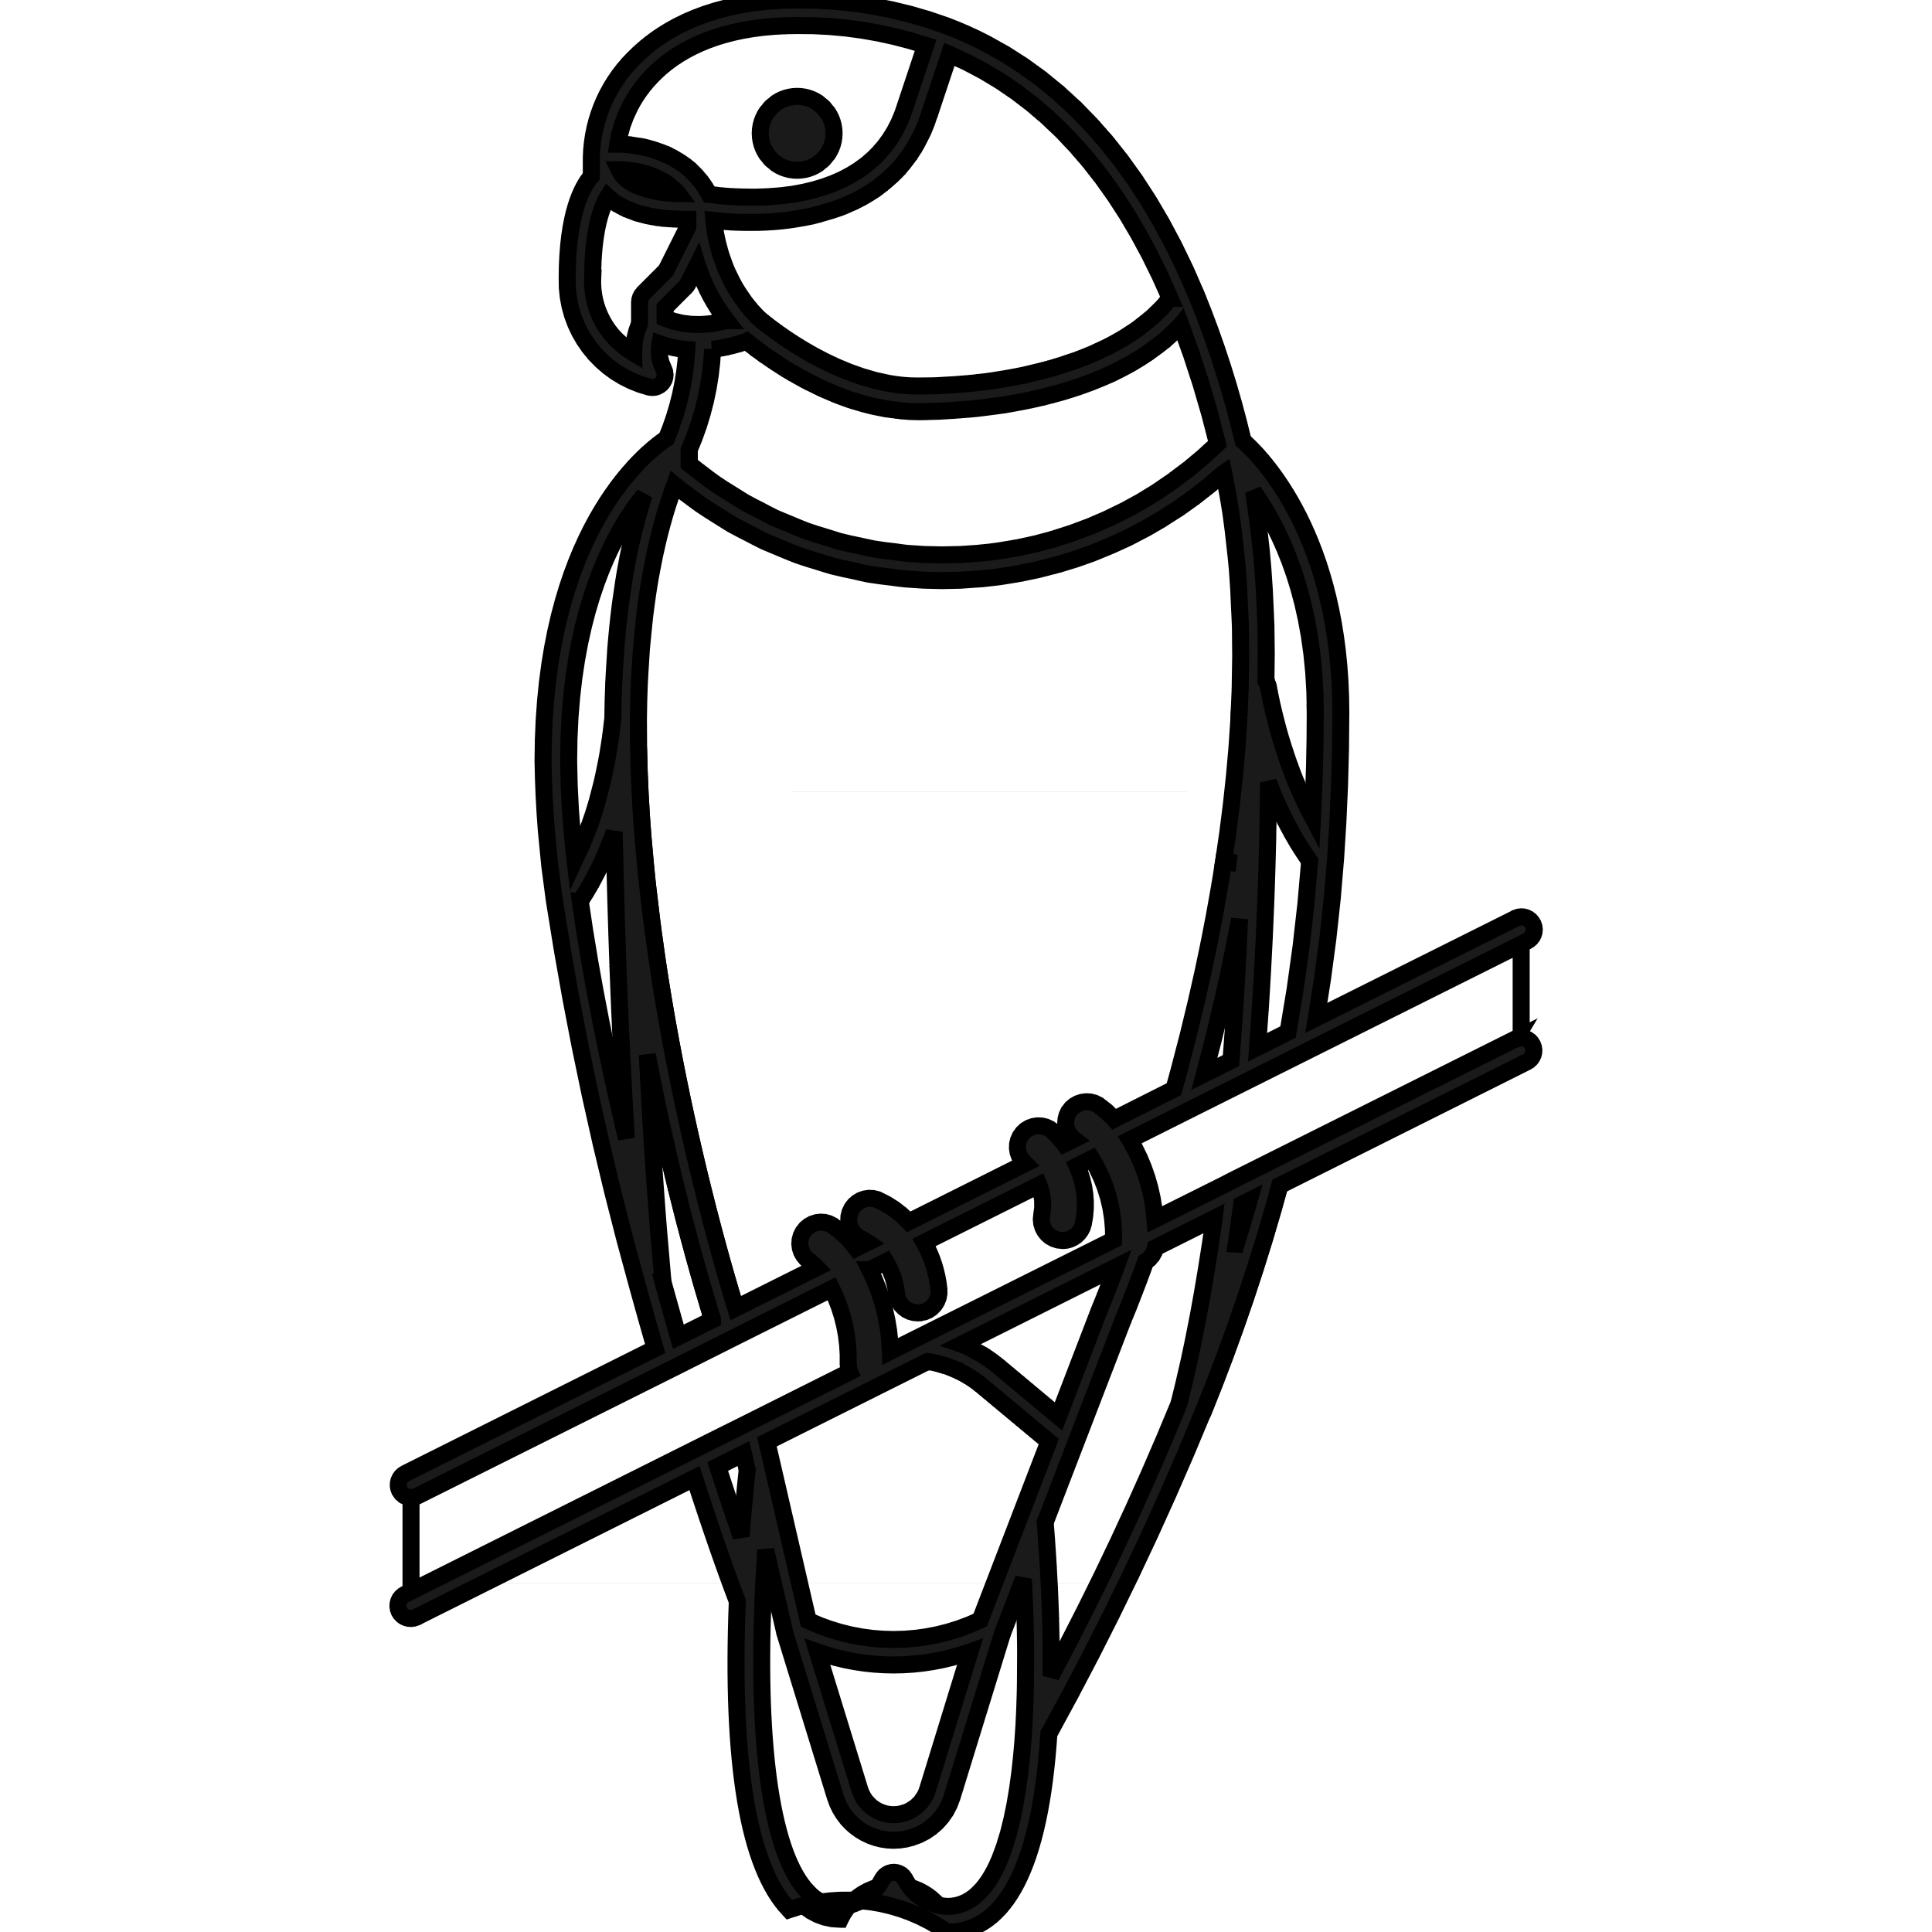

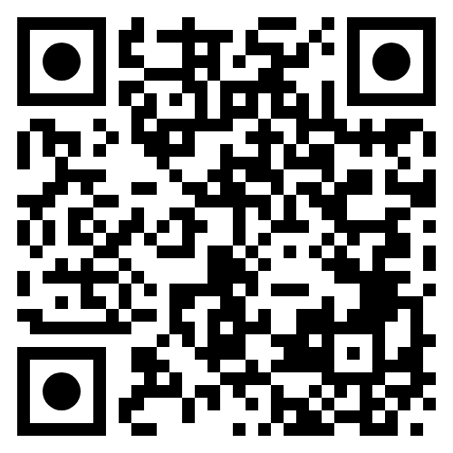
BeakPeek birding
Story
Identify 01
Locate 02
Learn 03
Through:
Species
Genus
Common Name
Where birds are, at what time of year.
How rare they are.
What birds sound like.
What they look like.
Their information.
Are they endangered?
Google Play Link

Slide 3
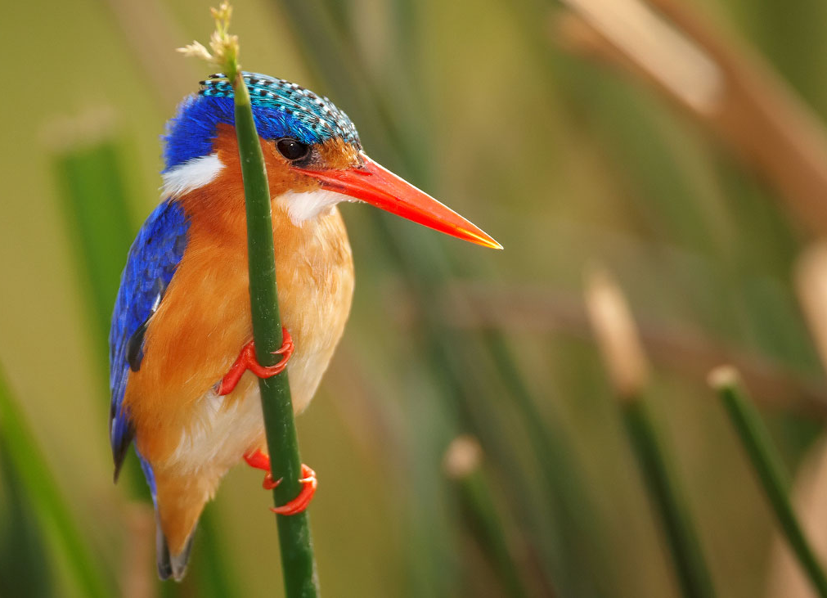
BEakPEEK
Core Quality
TESTING
usability
Performance
security

Slide 4
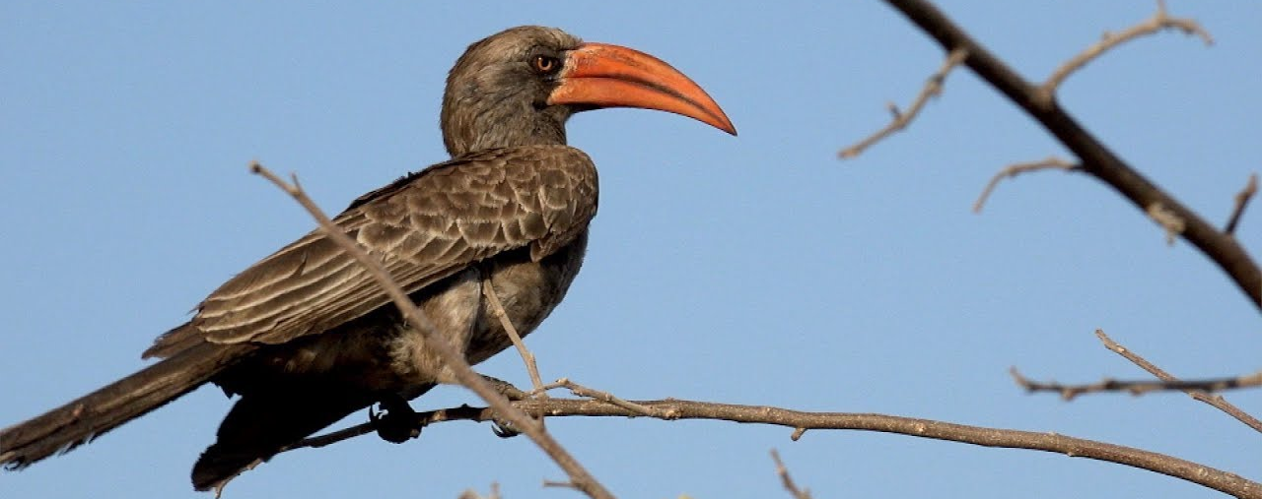

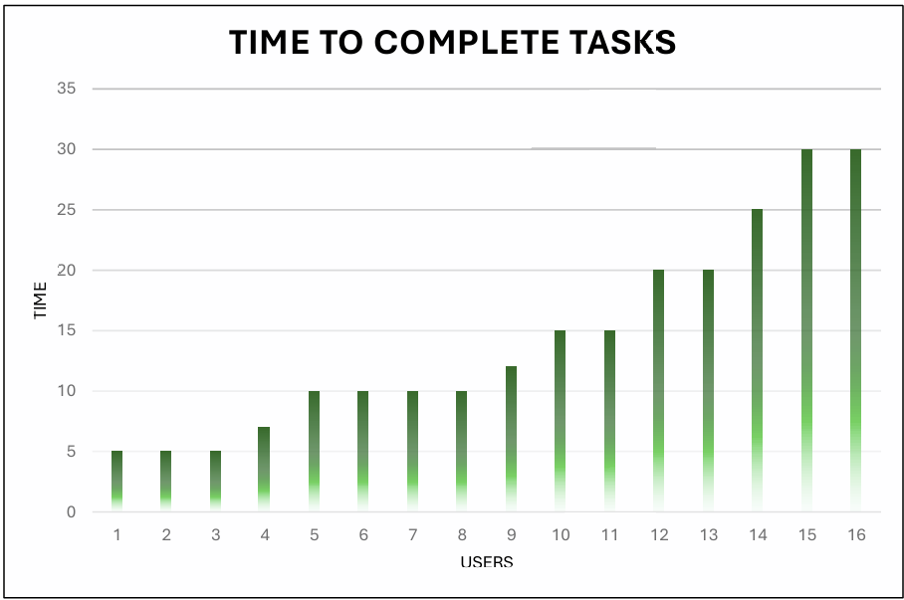
CORE Quality
Testing
Usability
Useability Test
User time to complete tasks
All comments collected and addressed
Average Time: 14,3 minutes
User Manual
Screenshots added
Common problems addressed
Notes:
Users without technical experience must be considered

Slide 5
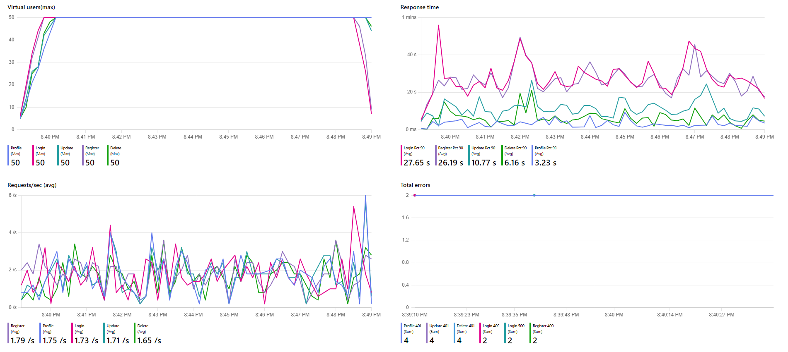
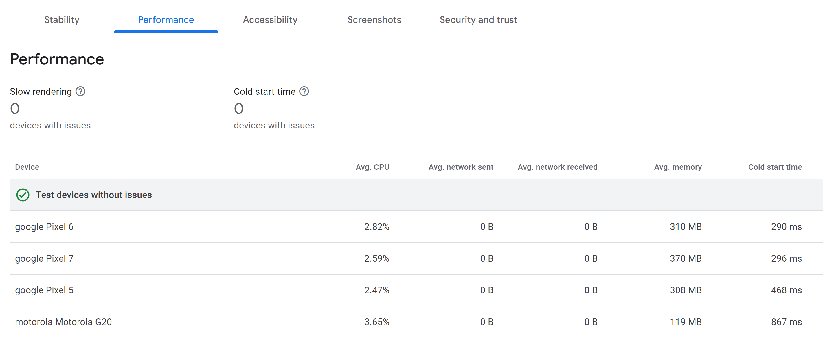
CORE Quality
Testing
Performance
1.1 Azure load testing.
Microsoft Azure
Stress Testing

Slide 6
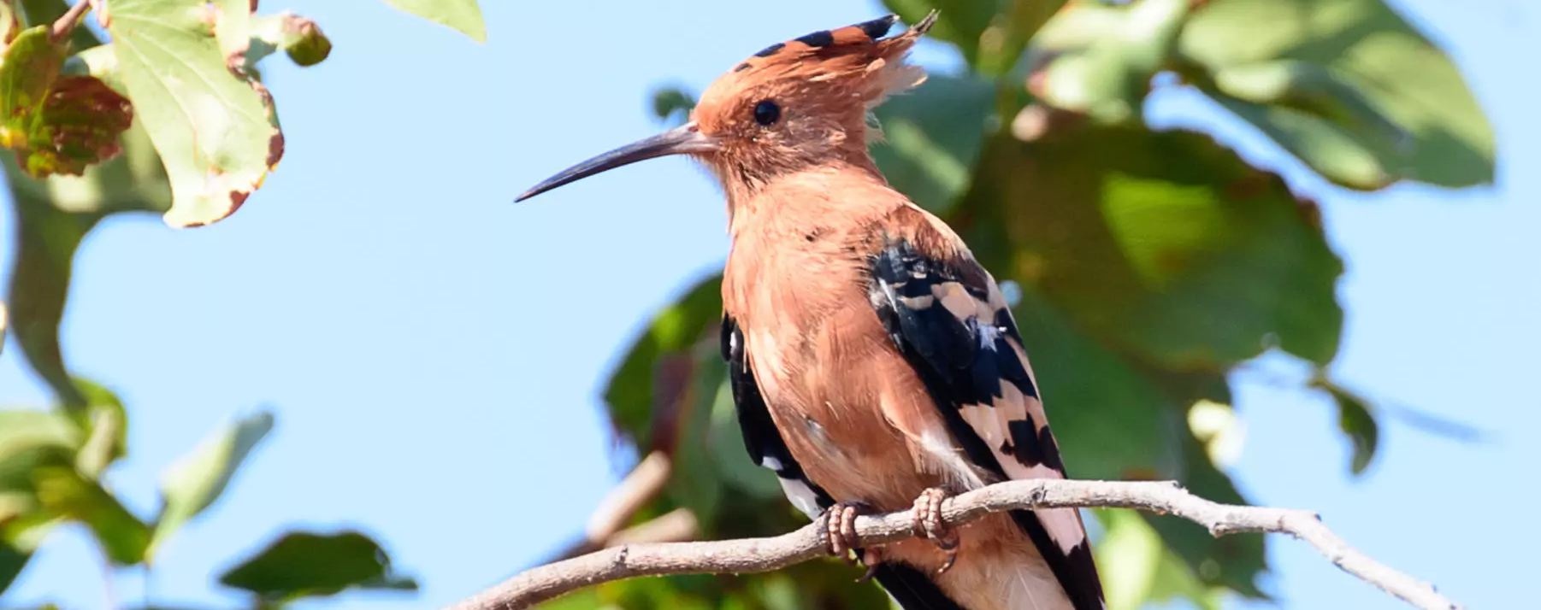
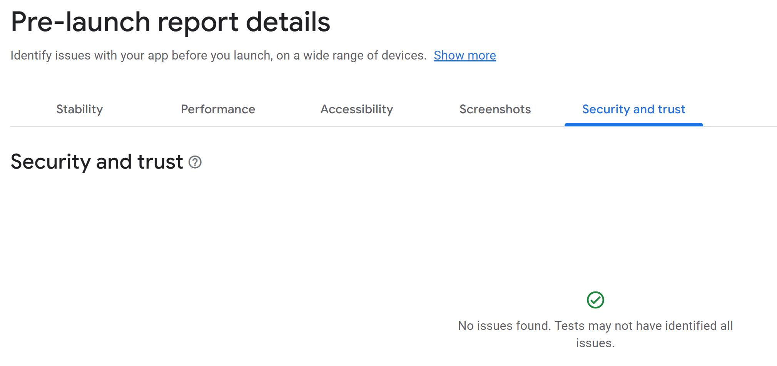
CORE Quality
Testing
Security through azure / Google play
Azure:
Our security standards are achieved through the use of JWT Tokens and ASP.NET Core Identity framework.
Mobile Application Security Assessment:
Meeting MASVS Level 1 requirements allows us to identify key vulnerabilities in our application ensuring a strong baseline level of security.

Slide 7
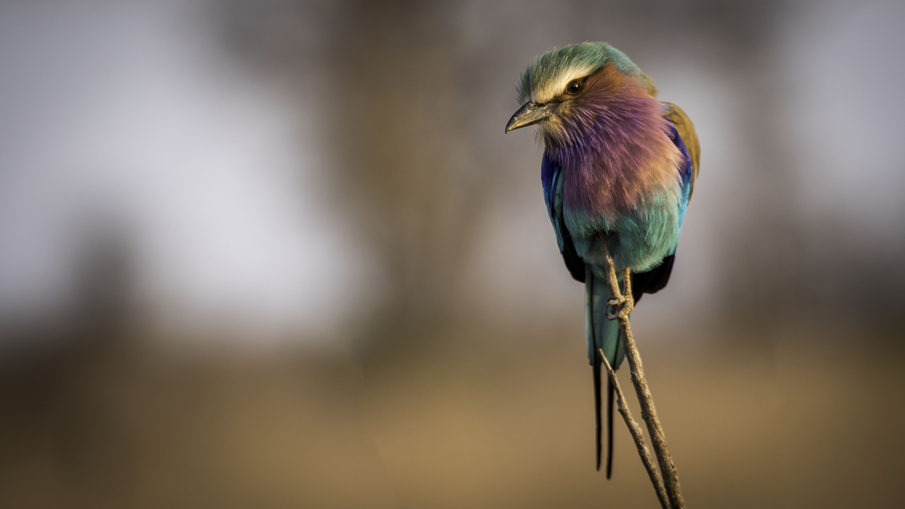
Project Management
Agile Scrum
Team Structure
Meetings:
+ Daily
+ Bi-Monthly
+ Client
+ University Mentor
+ Industry Mentor
Tickets: GitHub and Discord
Charl: Team Lead, UX, Docs, Data Science.
Justin: Integration, Frontend, Birding.
Jarod: Backend, Frontend, Offline Data.
Ivan: Backend, Online Data, DevOps.
Matthew: UI, Frontend, UX

Slide 8
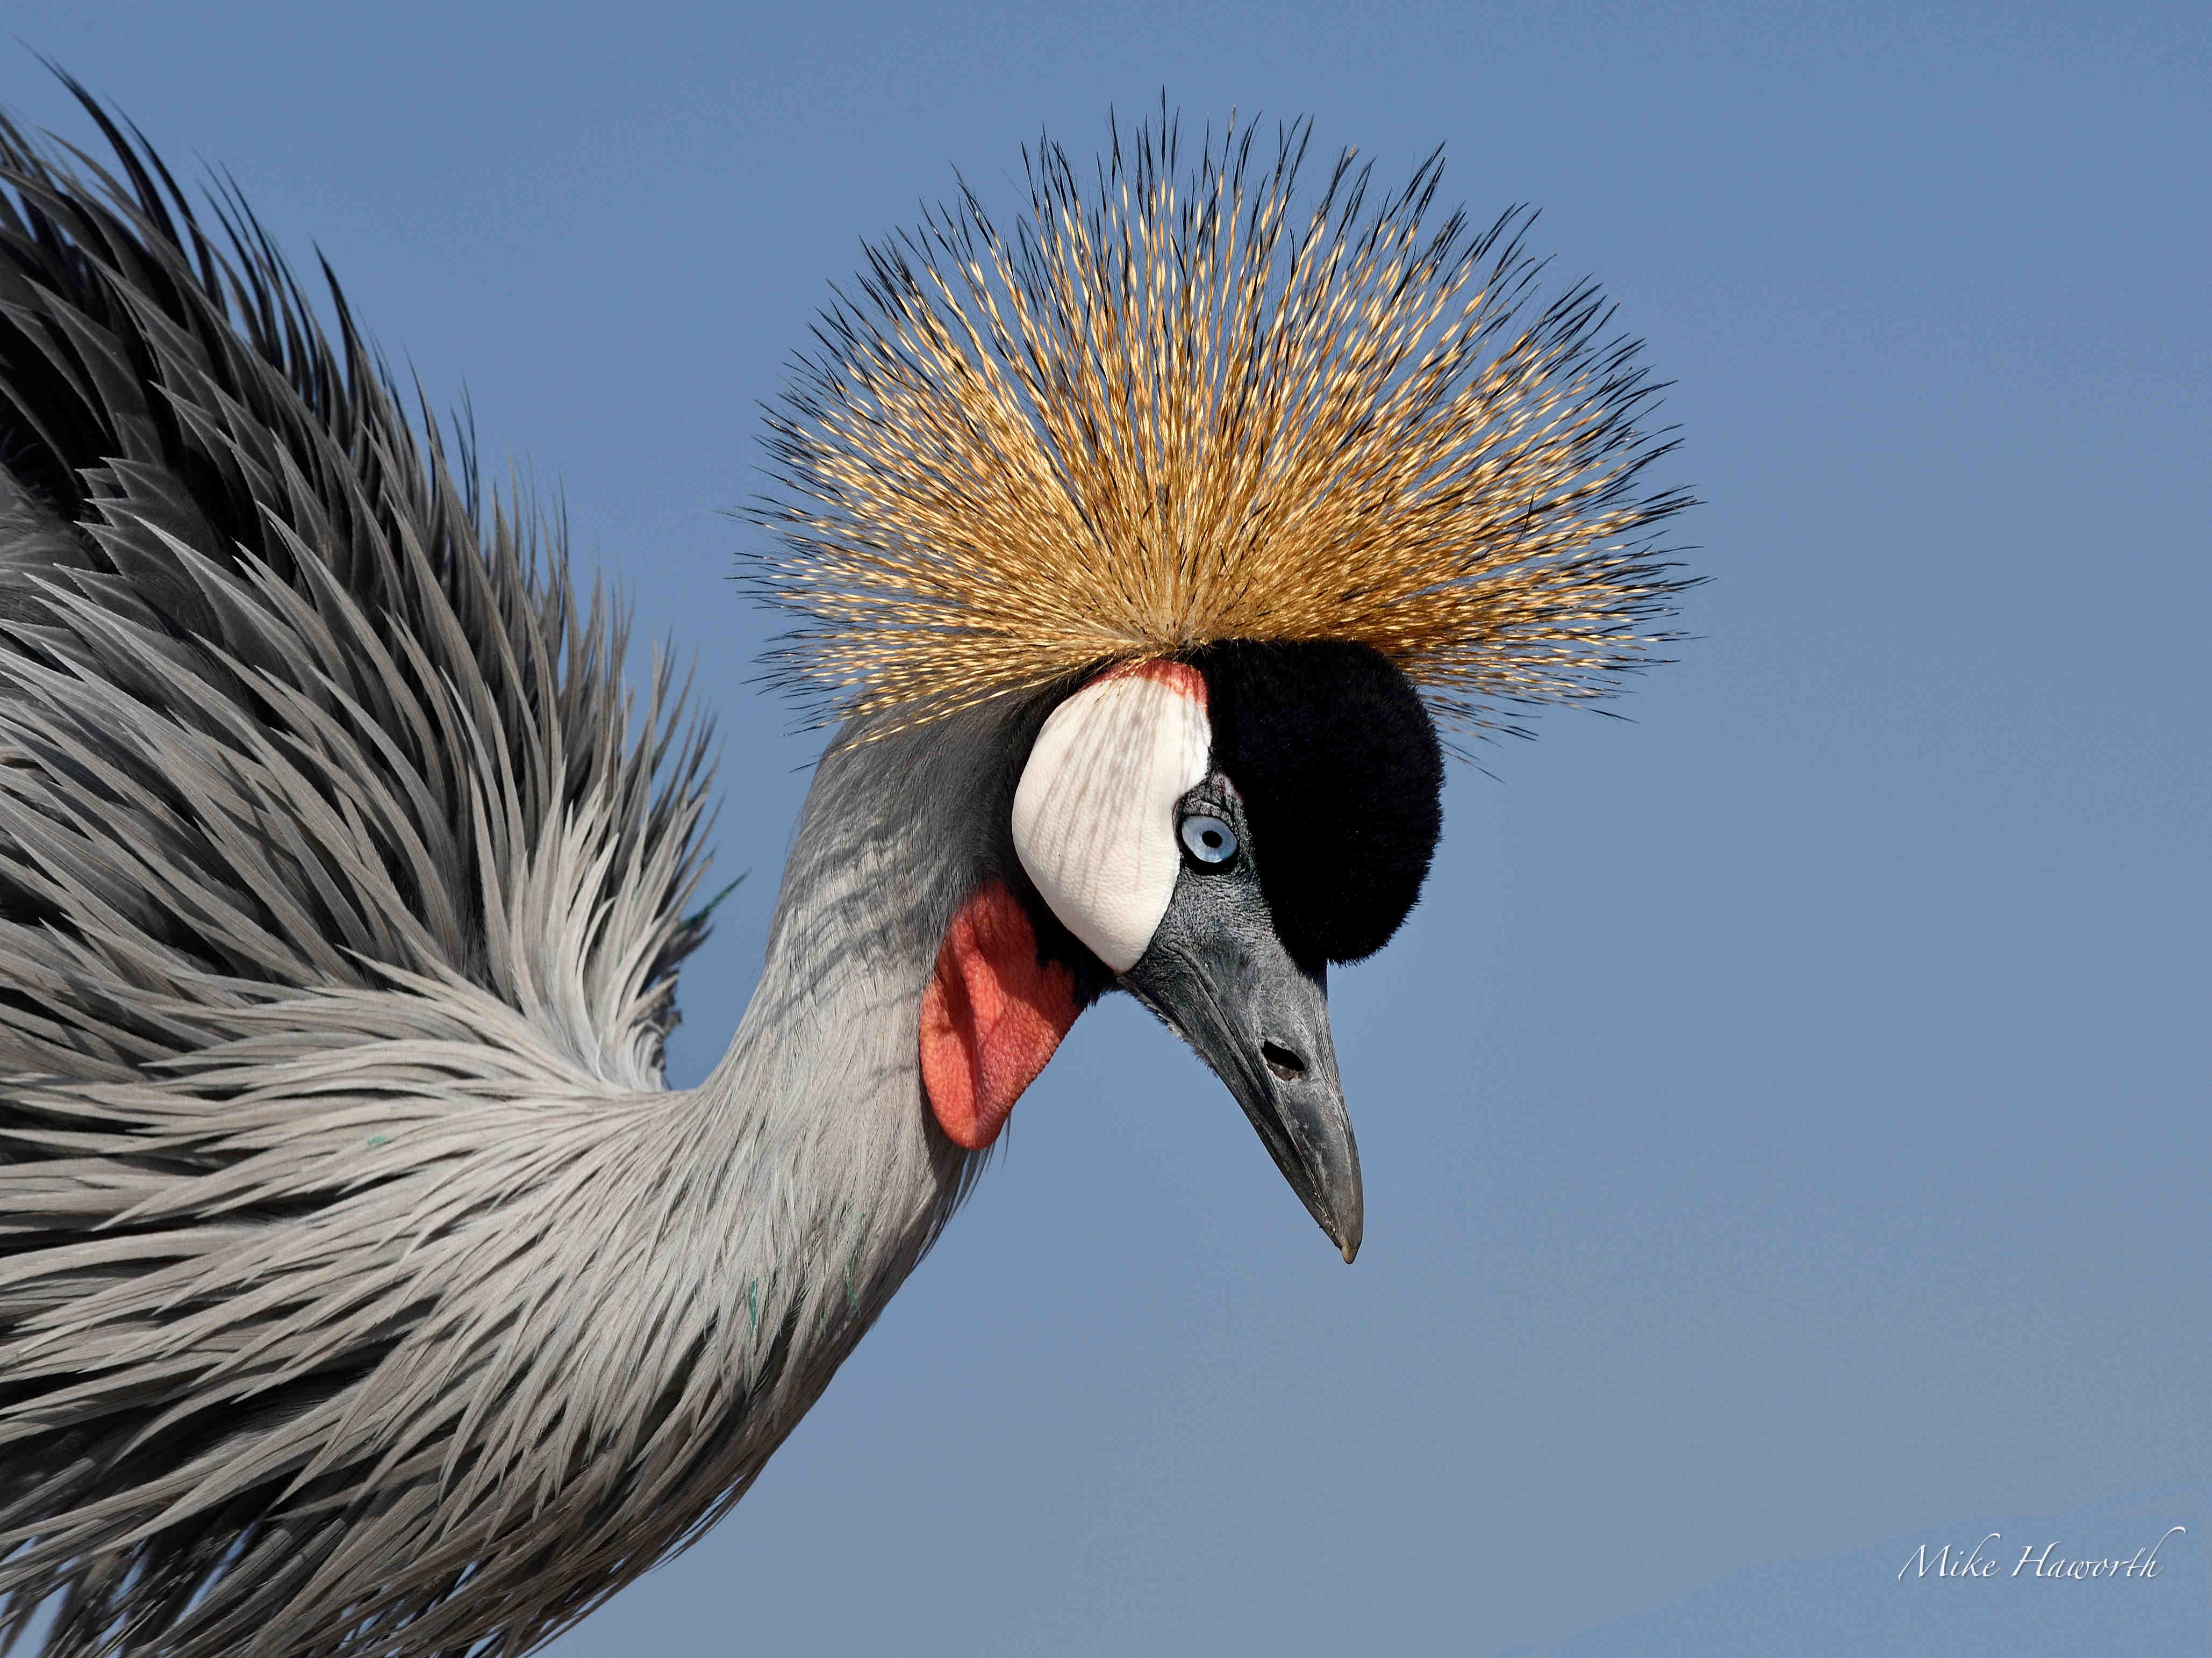
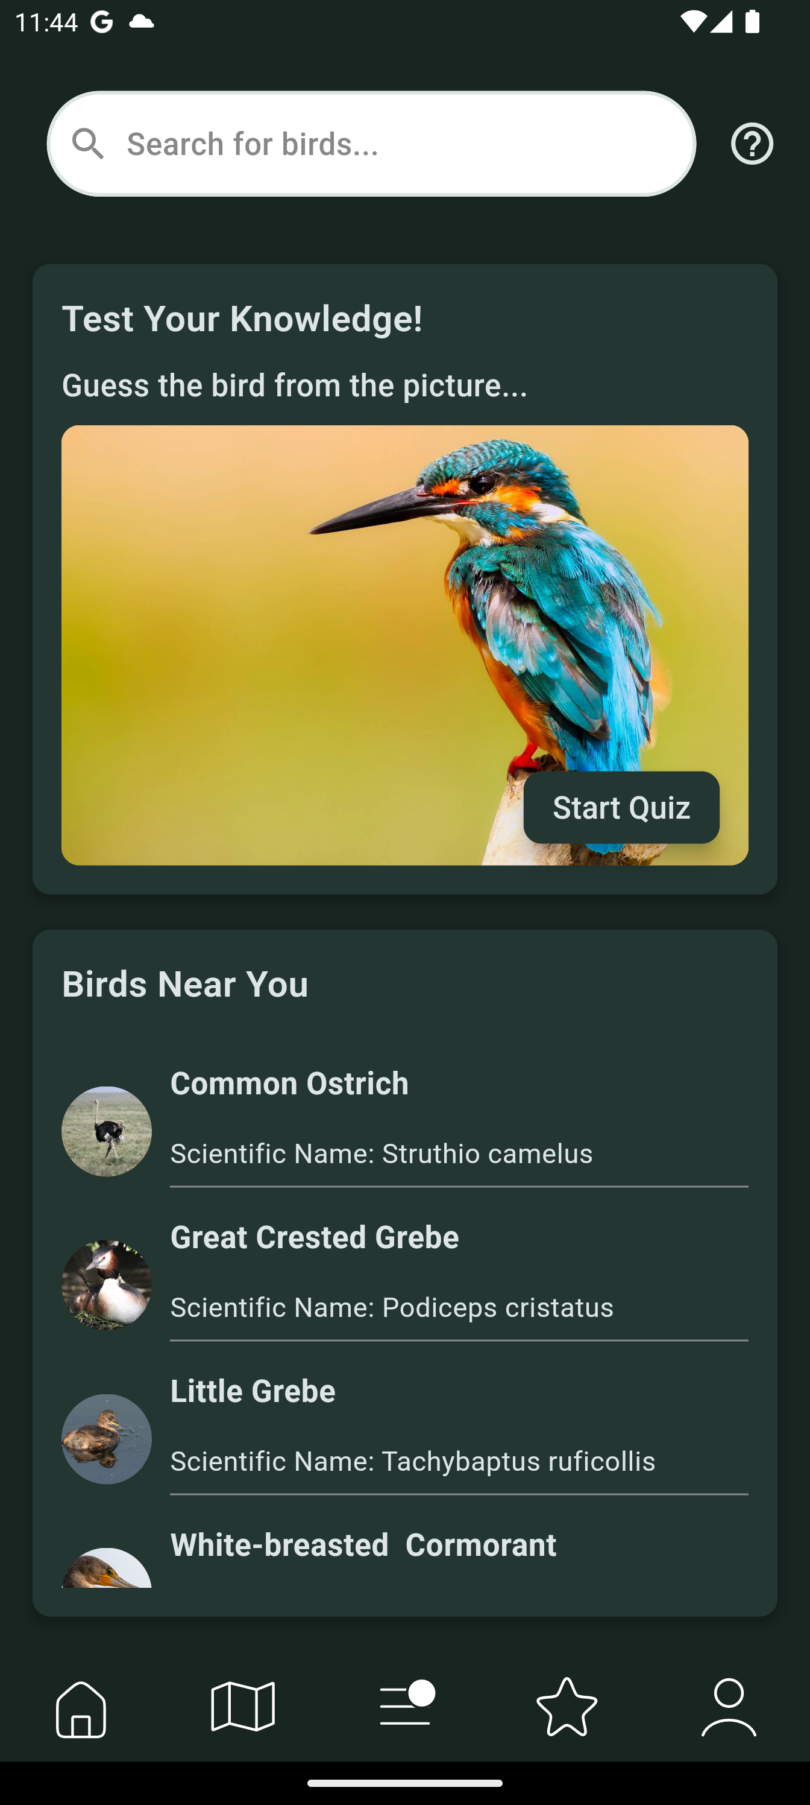
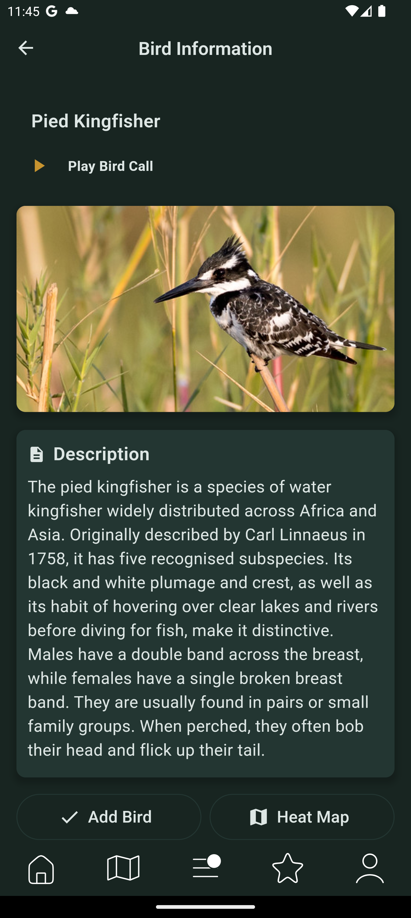
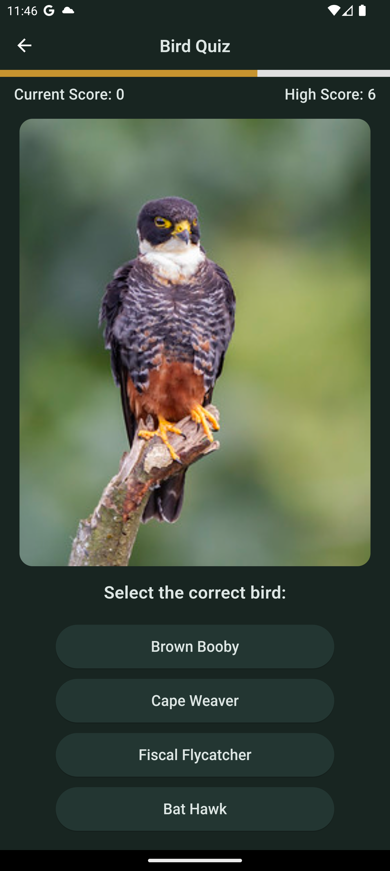


WOW Factors
Gamified
Bird Quiz
Expanding bird knowledge.
Fun twist to your average birding app.
High score encourages competition.
Bird Population Estimate
<10% under estimation.
All birds >1% Reporting Rate.
All birds with >1% South African Coverage.
Google Play Public Launch
Internal App Launched.
Public Publication in for review.
App Security and Performance.

Slide 9
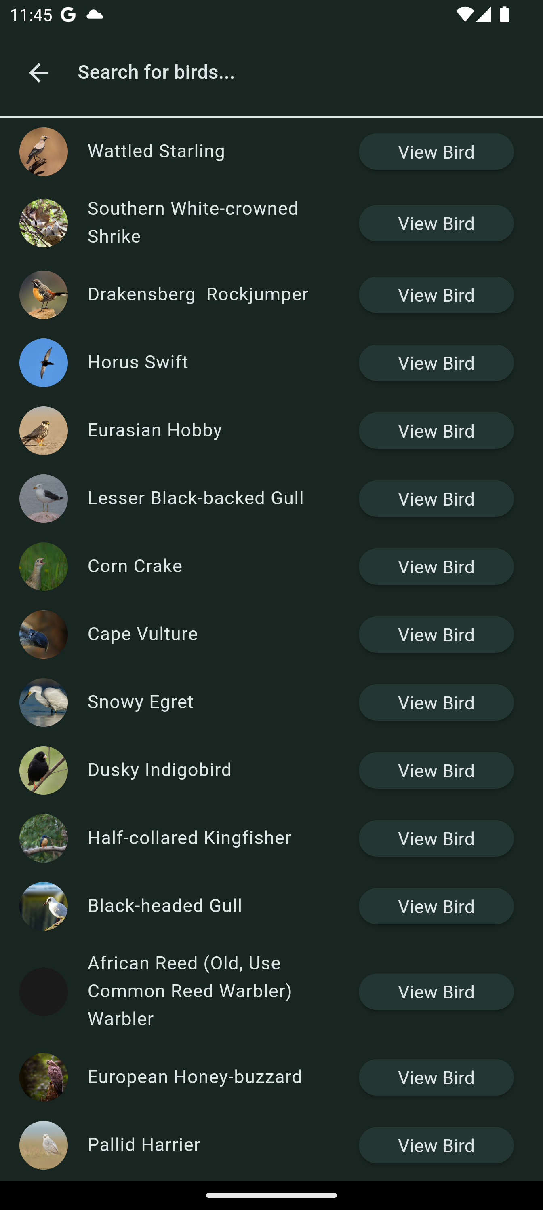
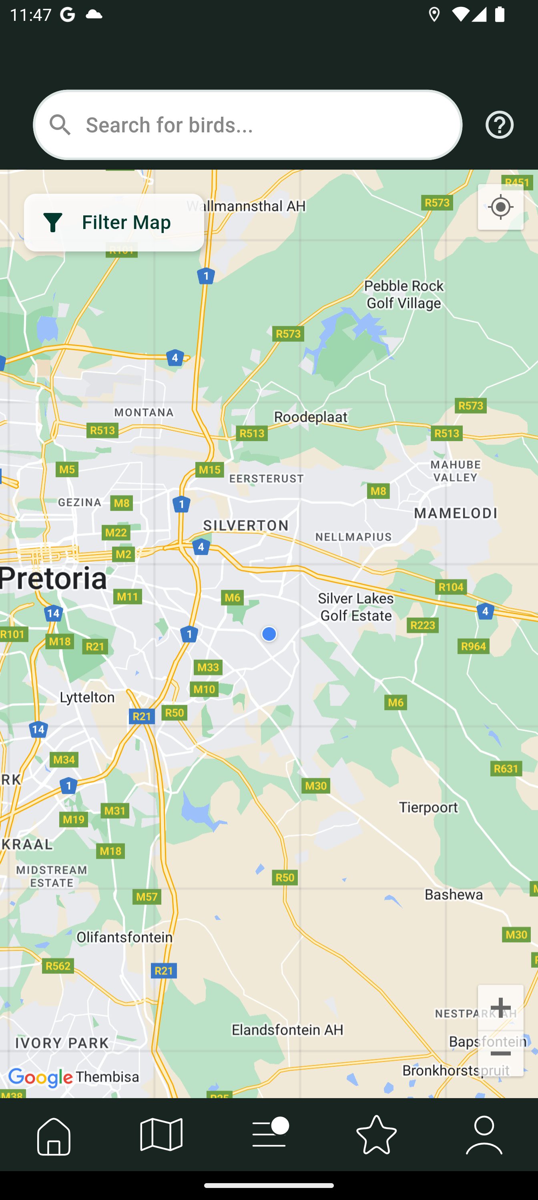
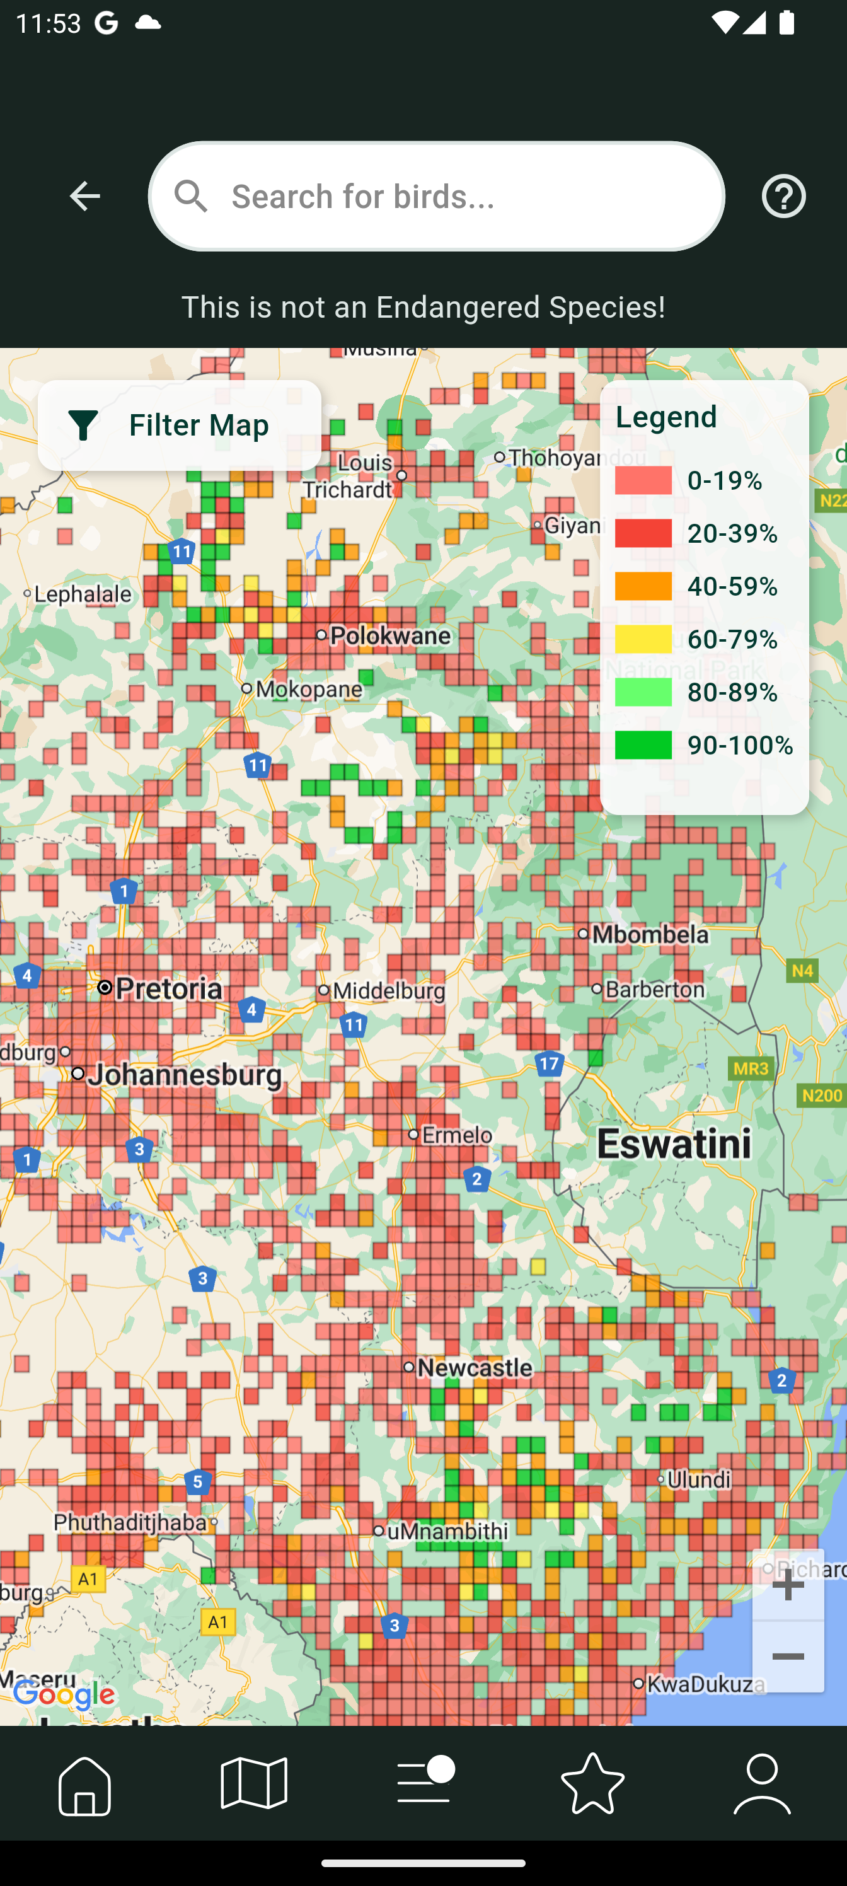
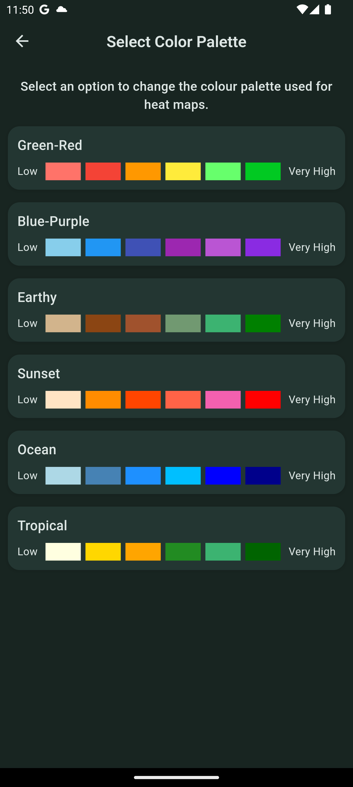
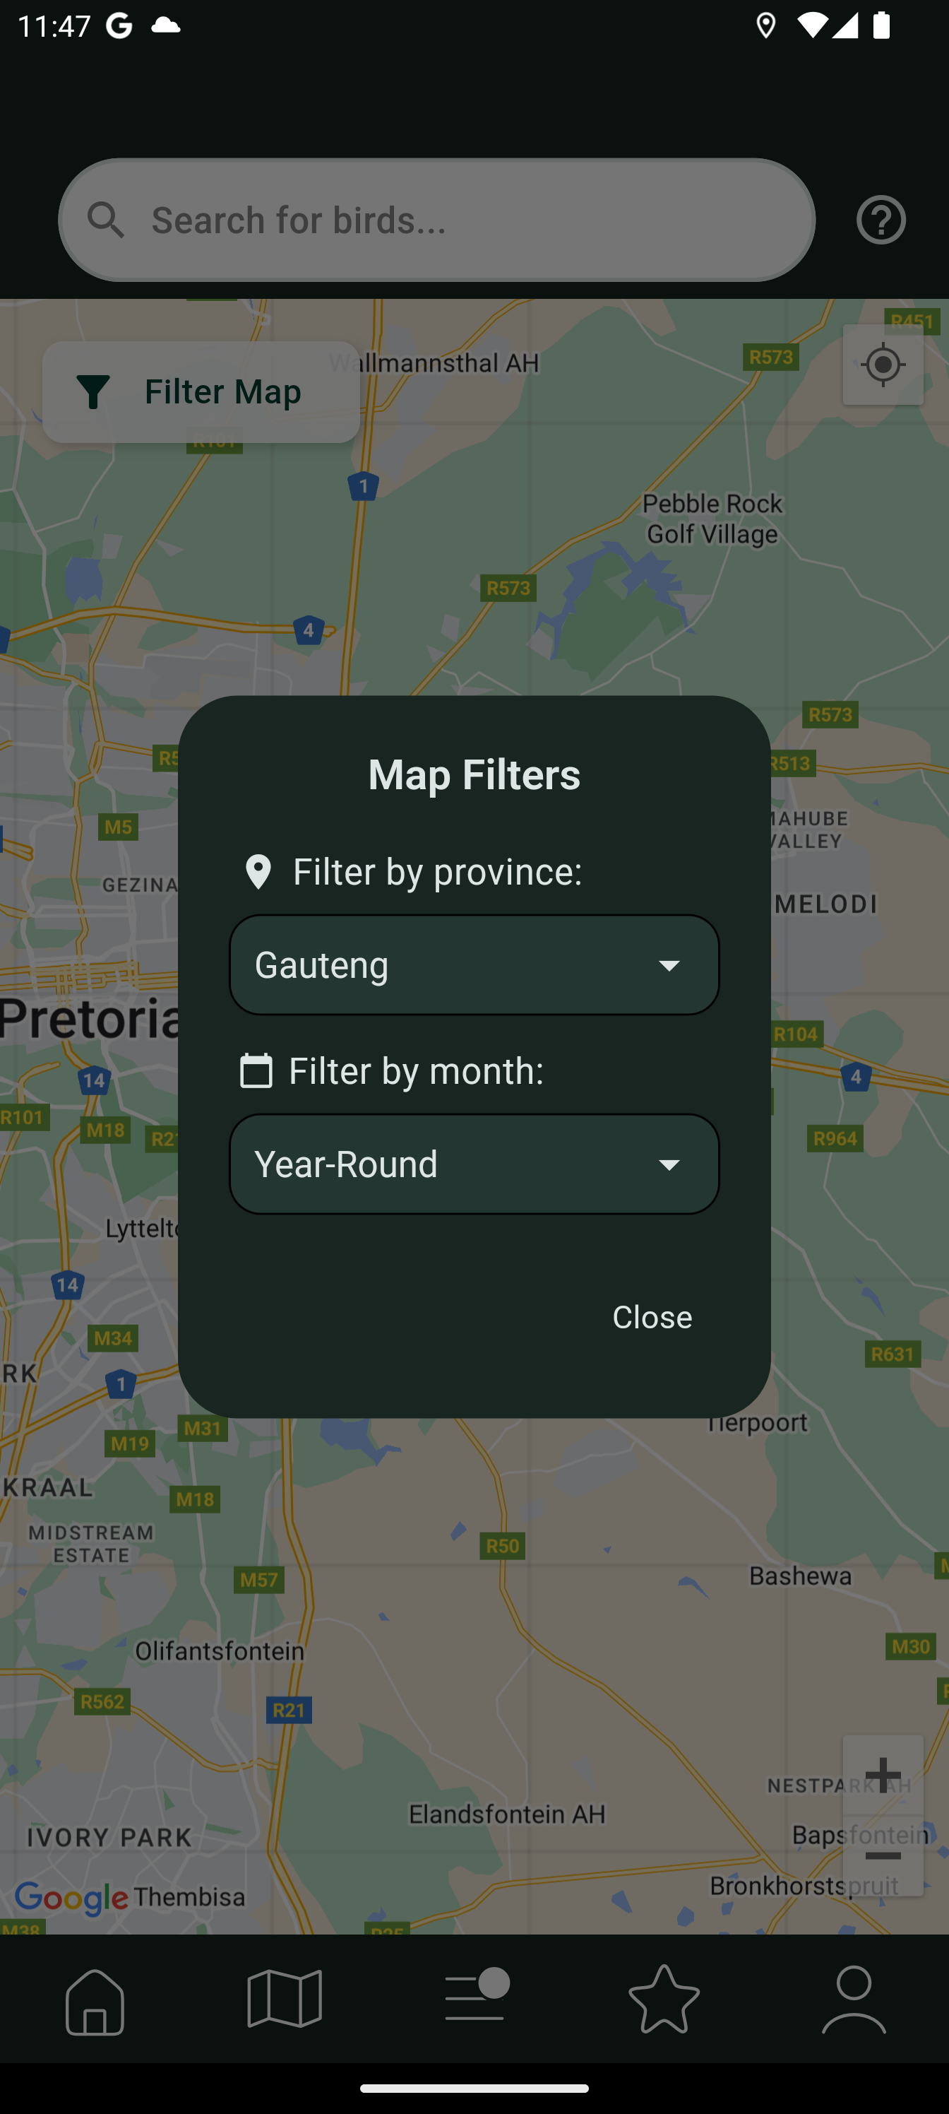
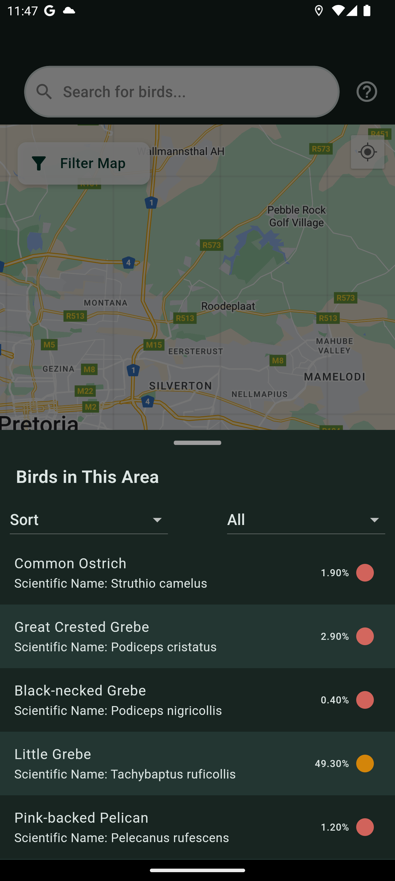
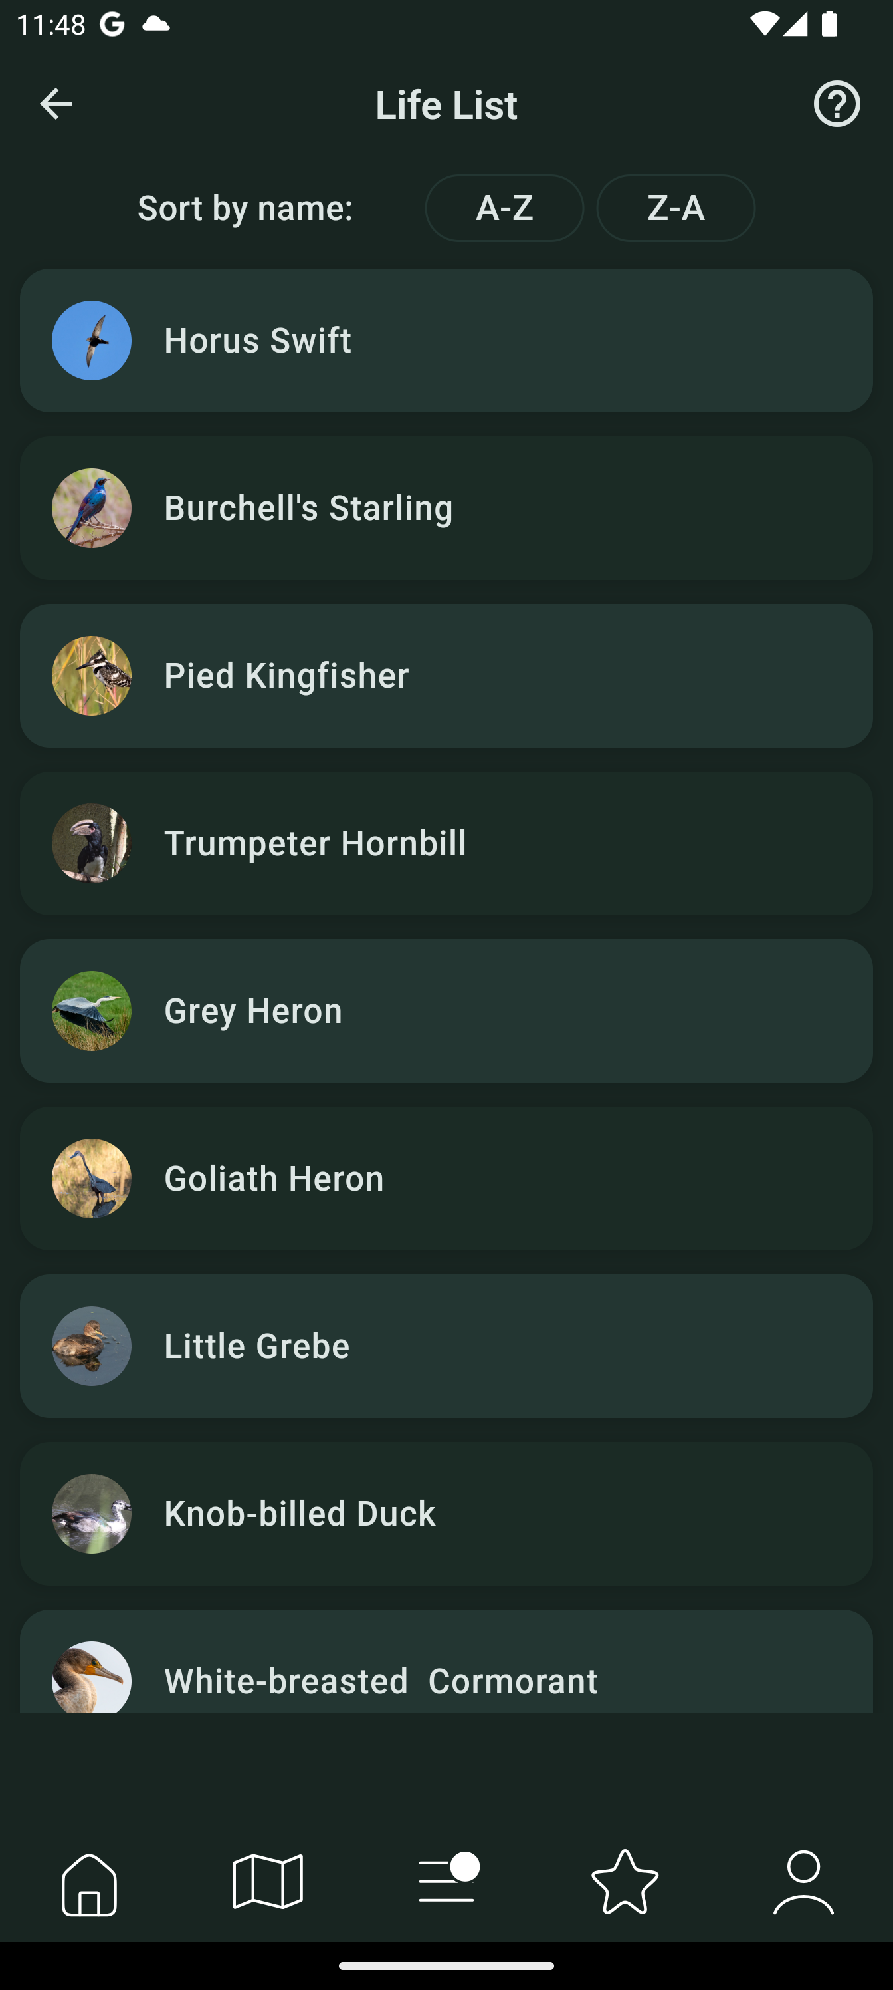
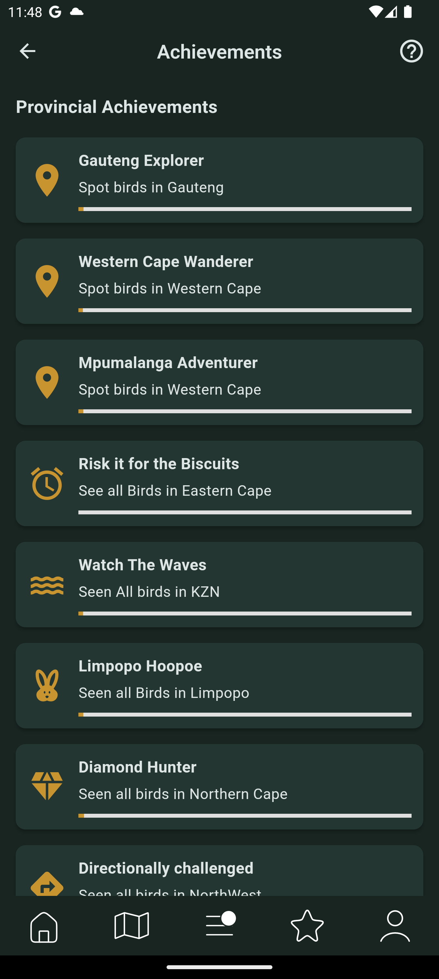
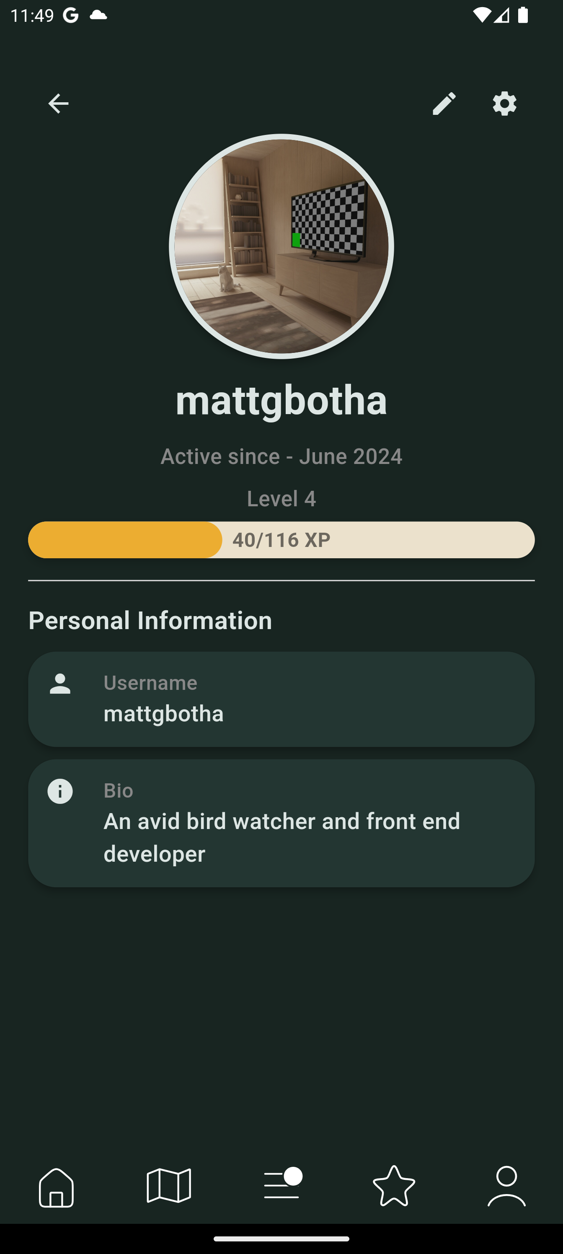
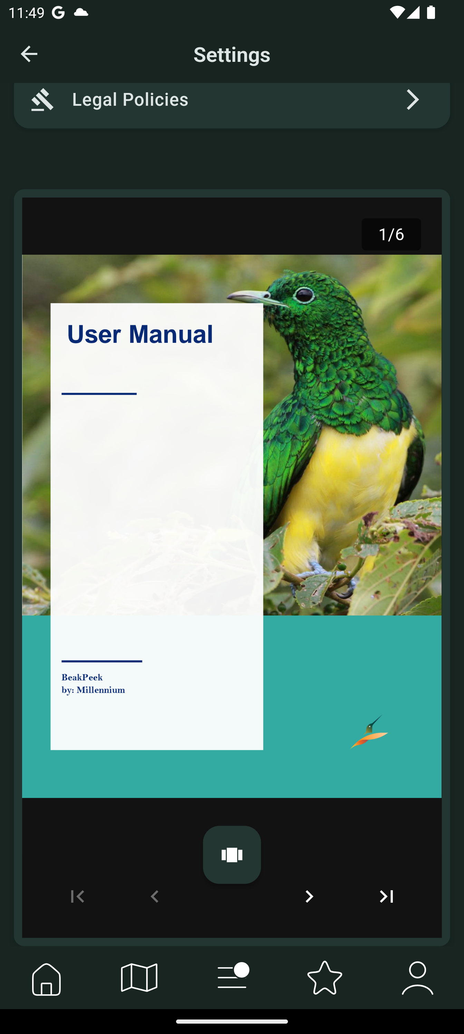

Slide 13
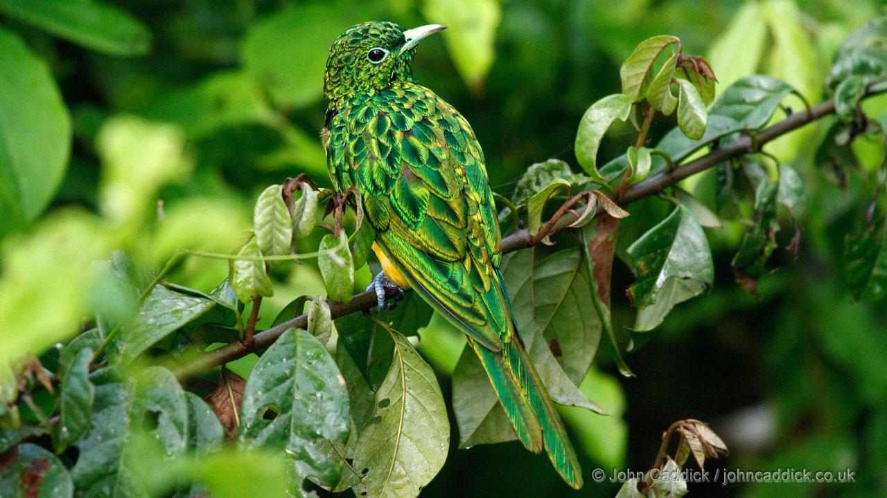
ThankYou
BeakPeek
millennium.capstone@gmail.com
Group 22
Charl Pretorius

